Slide 1

Building a Calculator with Tkinter
In this presentation, we'll explore how to create a fully functional calculator application using the powerful Tkinter GUI library in Python. We'll cover the key steps, from importing the module to handling calculation errors and creating a polished user interface.
AT
by Abhinav Tiwari

Slide 2
Importing the Tkinter Module
Tkinter Overview
Importing Tkinter
Tkinter is the standard GUI library for Python. It provides a comprehensive set of widgets and tools for building desktop applications.
To use Tkinter, we first need to import the module at the beginning of our Python script.

Slide 3
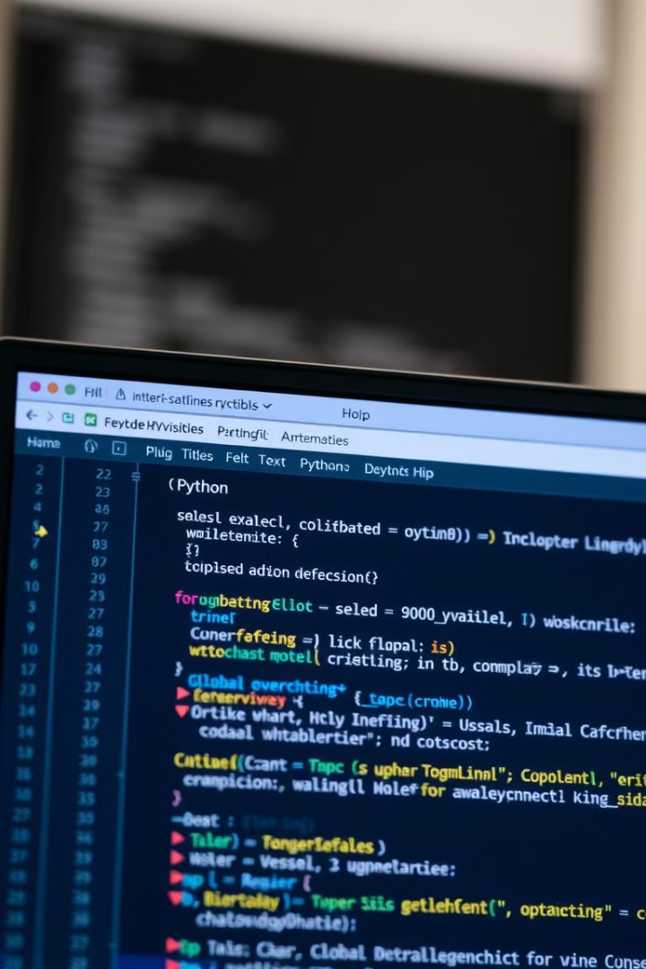
Defining Global Variables
Calculation String
Tkinter Window
We'll store the current calculation in a global variable called "calculation".
We'll create a Tkinter window object to hold our calculator UI elements.
Text Display
We'll use a Tkinter Text widget to display the current calculation.

Slide 4
Creating Addition Function
add_to_calculation()
Updating Display
This function will append the user's input to the calculation string.
After each input, we'll update the Text widget to show the current calculation.

Slide 5
Implementing Evaluation Function
evaluate_calculation()
Error Handling
This function will evaluate the current calculation string using the built-in eval() function.
We'll wrap the evaluation in a try-except block to catch any errors and display an error message.

Slide 6
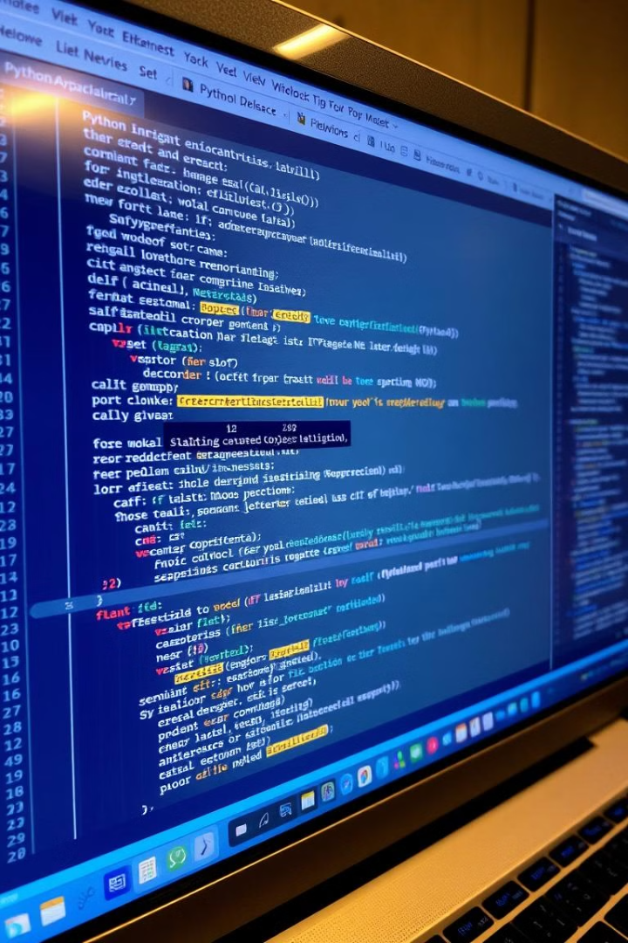
Handling Calculation Errors
Try-Except Block
Clear Calculation
If an error occurs during the evaluation, we'll catch it and display an error message.
We'll also clear the calculation string to reset the calculator.
Robust Error Handling
This ensures our calculator can handle a variety of invalid inputs gracefully.

Slide 7
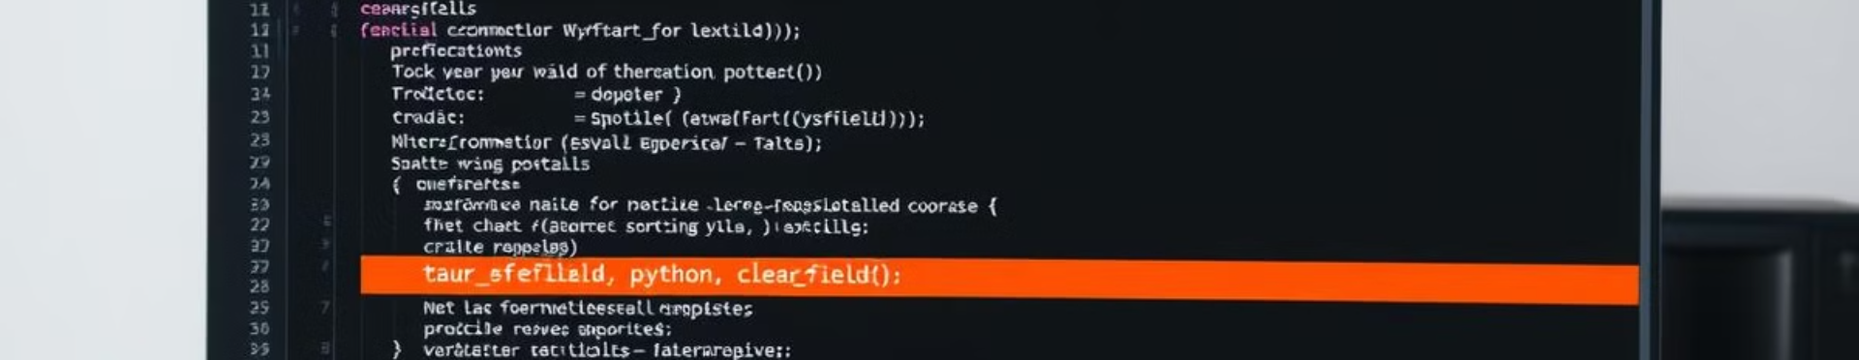



Clearing the Calculation Field
clear_field()
Resetting Display
User-Friendly
This function will reset the calculation string and clear the text display.
We'll delete the contents of the Text widget and set the calculation string to an empty string.
This allows users to start a new calculation easily.

Slide 8

Conclusion and Next Steps
1
Key Takeaways
2
Future Enhancements
We've created a fully functional calculator app using Python and Tkinter, with robust error handling and a clean user interface.
Explore adding more advanced features like history tracking, scientific functions, or a more polished visual design.
3
Continued Learning
Continue improving your Python and GUI development skills by building more Tkinter applications.

